Slide 1
Digital Integrated Circuits
Georgiana SIMION
2021/2022

Slide 2
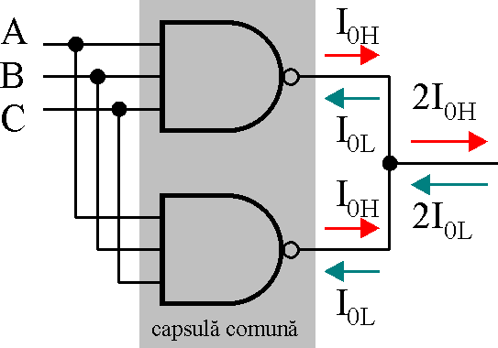
TTL – Usage Rules
Can be applied to other families (carefully)
It is forbidden to connect two or more outputs together
It is forbidden to connect the outputs to GND or V_{CC}
Way to connect two TTL outputs

Slide 3
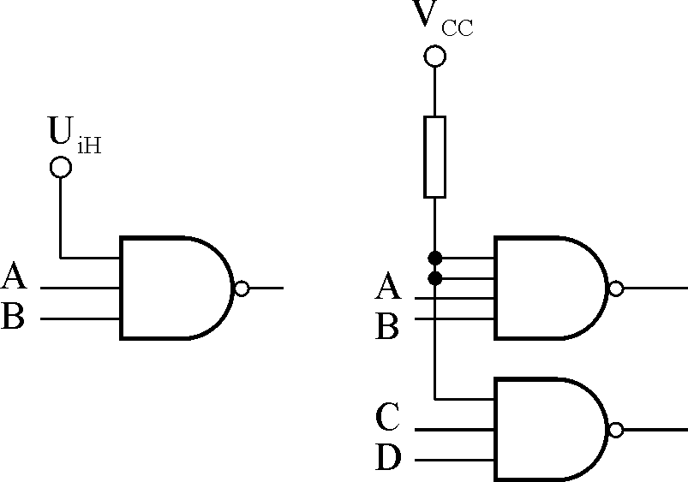
Usage Rules
No input can be let floating
No input can be let unconnected
Pull-up resistor
Rp

Slide 4
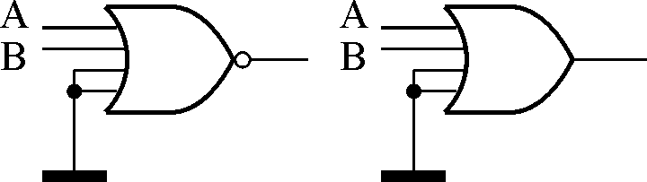
Usage Rules
pull-down resistor

Slide 5
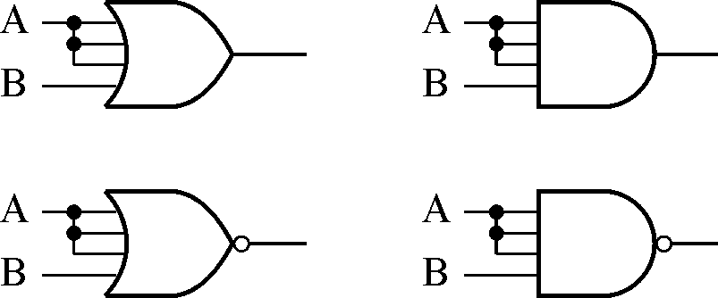
Usage Rules
Interconnect several inputs (from the same gate):
Advantage: simplicity,
Disadvantage: low performance (Why?)
For example,
I_{iL}_OR_A = I_{iL}_NOR_A = 3 I_{iL},
I_{iH}_OR_A = I_{iH}_NOR_A = 3 I_{iH},
I_{iL}_NAND_A = I_{iL}_AND_A = I_{iL} ,
I_{iH}_NAND_A = I_{iH}_AND_A = 3 I_{iH}
Notes:
Conectarea intrărilor nefolosite la intrări folosite: avantajul acestei metode este simplitatea, nemaifiind necesară rezistenţa R_{P}. Dezavantajele metodei sunt legate de multiplicarea capacităţii de intrare C_{i} şi a curenţilor de la intrare în starea SUS, iar suplimentar pentru porţile SAU şi SAU-NU şi multiplicare curenţilor de intrare în starea JOS.

Slide 6
Usage Rules
Unused gates – inputs must be connected also
Handling - ESD
Decoupling is mandatory.

Slide 7
Usage Rules
High switching supply current
Decoupling
Solving for C yields:
But
So:

Slide 8
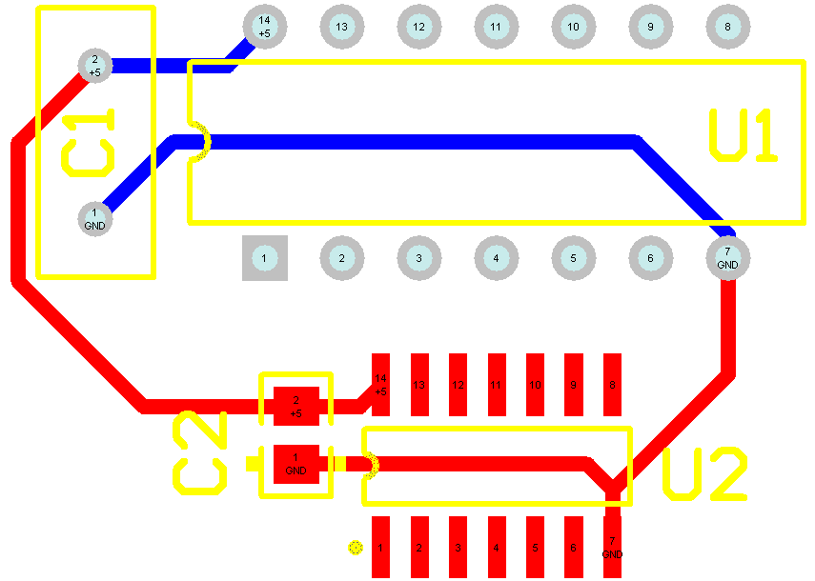
Decoupling
I_{CC} >= 15 I_{CC_NAND}
C = 50 ... 100 nF
C near each IC

Slide 9
Applications – driving loads with totem-pole outputs

Slide 10
Driving a LED
Widely used
5 mm LED - U_{d}= 1.7 ... 2 V @ 10 mA
SMD LEDs-3-5 mA
I_{0L} =16 mA >> I_{0H} =0,8 mA

Slide 11
HOMEWORK
Schematic design

Slide 12
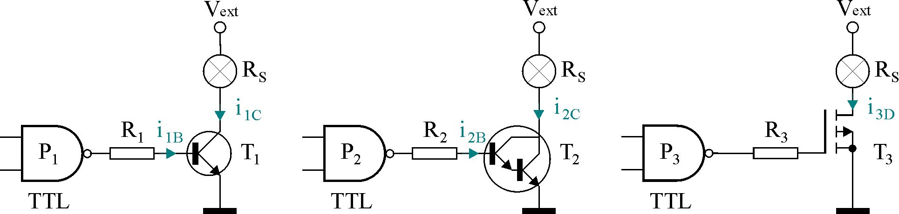
Driving higher currents
u₀ = U_{0L} (Tr OFF); u₀ = U_{0H} (Tr ON - sat)
ForT₁: (Ic results 80 ... 300 mA)

Slide 13
Driving higher currents
For T₂ (I_{c} >= 1A):
Usually R₂ = 1 kΩ (why?); verify I_{0HMax}

Slide 14
Driving higher currents
Using a n MOS transistor (may be SMD)
Low r_{ds}
Heatsink (?)
R3 (?)

Slide 15
Homework
Automotive bulb, 12 V/5A
Select the Darlington / MOS transistor
Compute P_{D}
Choose a heatsink

Slide 16
TTL Three State Circuits

Slide 17
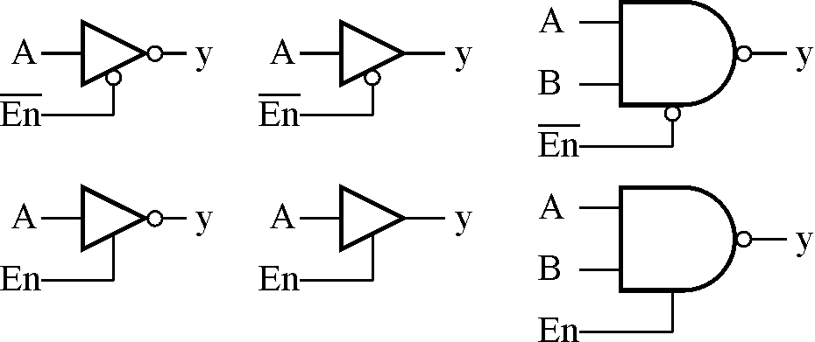
3 state gates
Homework: Datasheets for all 3 state gates; study 74xx244

Slide 18
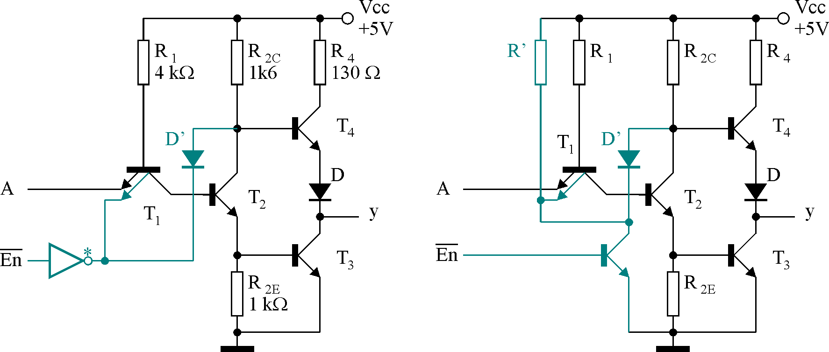
Schematic
Have also an Enable (EN or nEN) input
If EN = 0, y = HiZ

Slide 19
Three State Gates
If nEN = 0, y = /A
If nEN = 1, y = A
I_{0ZM} = ± 40μA

Slide 20
Three state circuits
1 bit wide bus
N bits wide bus:
Data Bus
Address bus
Control Bus
Combinations of above busses

Slide 21
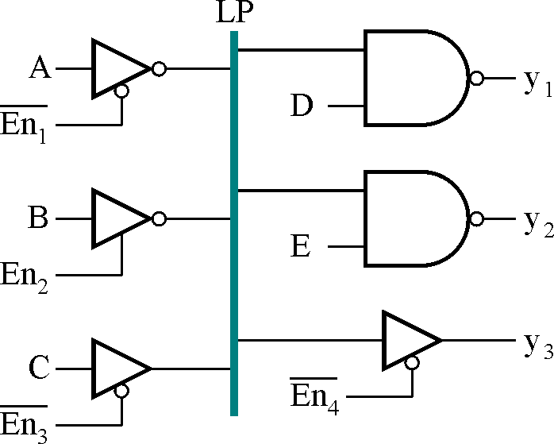
1 bit wide bus

Slide 22
Three state circuits
We can interconnect inputs (receivers) and only 3-state outputs (transmitters)
Rules
Only one transmitter active: , ie.
Only one transmitter active even when switching, so: t_{pNZ} < t_{pZN}
Current balance (inputs and outputs)

Slide 23
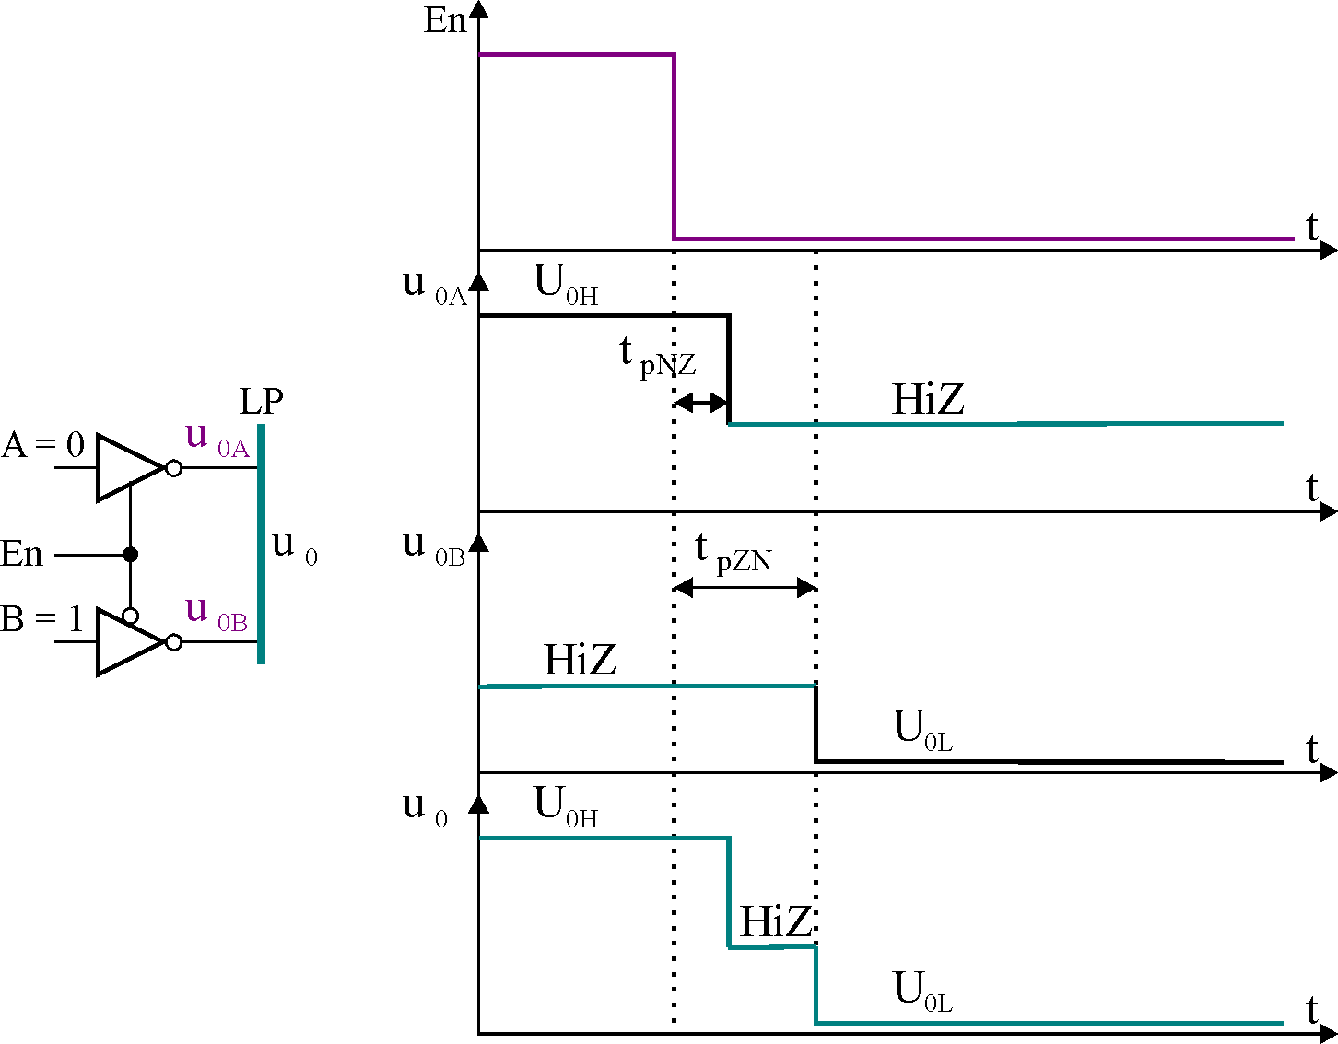
Evaluating t_{pNZ} and t_{pZN}

Slide 24
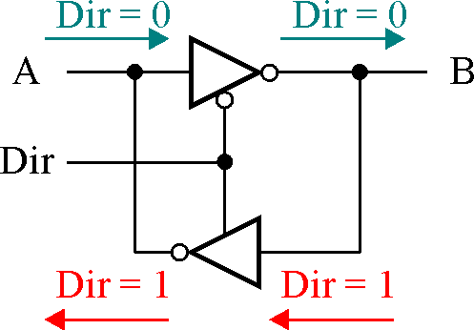
Bidirectional transmission line
If DIR = 0, A -> B,
If DIR = 1, B -> A

Slide 25
TRIGGER SCHMITT circuits

Slide 26
TRIGGER SCHMITT circuits
Purpose:
allowingt_{f} > 100 ns
Higher noise margin (compared to ΔUz = ± 0,4V)
Architecture: include a Schmitt circuit in an inverter

Slide 27
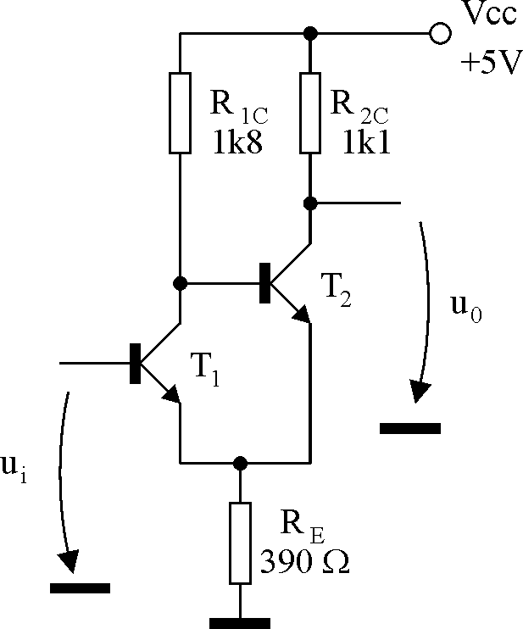
TRIGGER SCHMITT circuits
The circuit triggers when each trigger level (Low and High) is met in the right direction: (Up ↑and Low ↓)
Former implementations: tranzistors, OpAmps, TTL, CMOS, etc

Slide 28
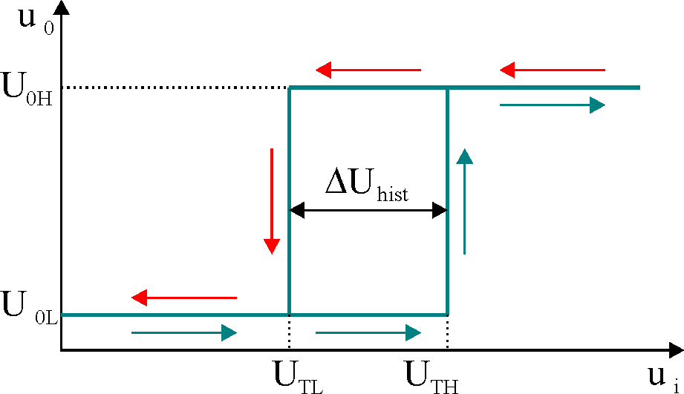
TTL TRIGGER SCHMITT circuit
Positive feedback speeds the switching process
The transfer characteristic (transistor circuit):
The hysteresis is: ΔU_{hist} = U_{TH} - U_{TL}

Slide 29
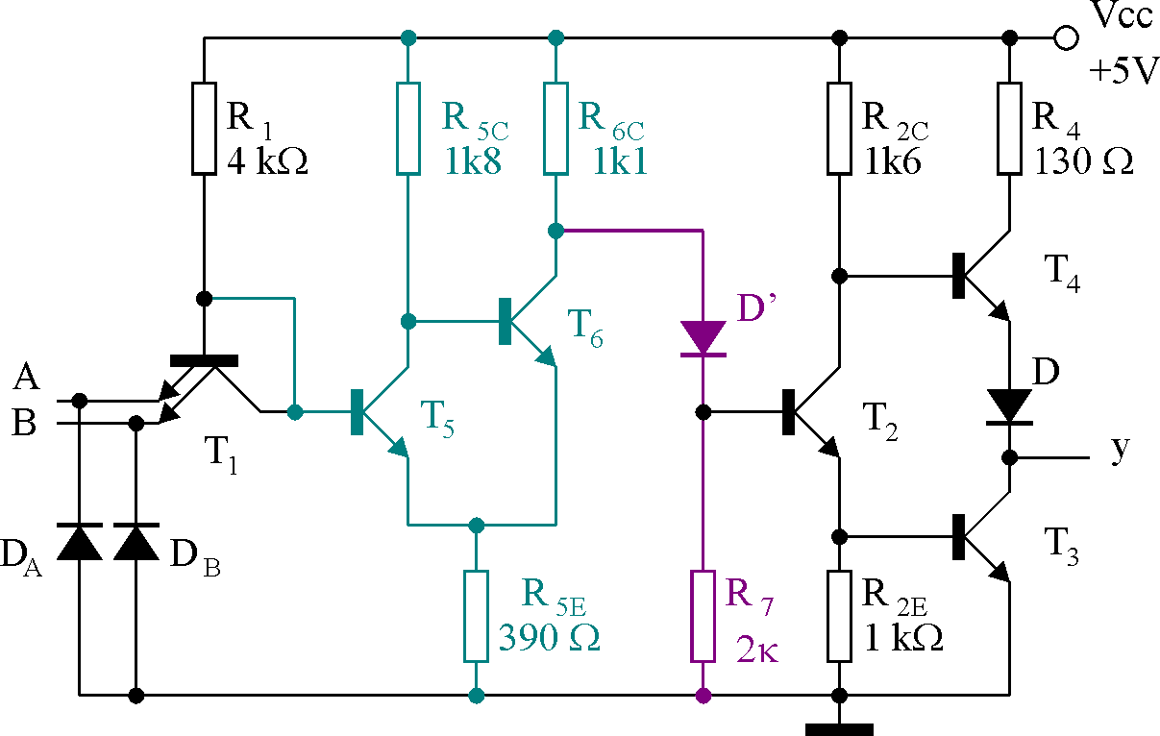
Trigger Schmitt schematic (74132)

Slide 30
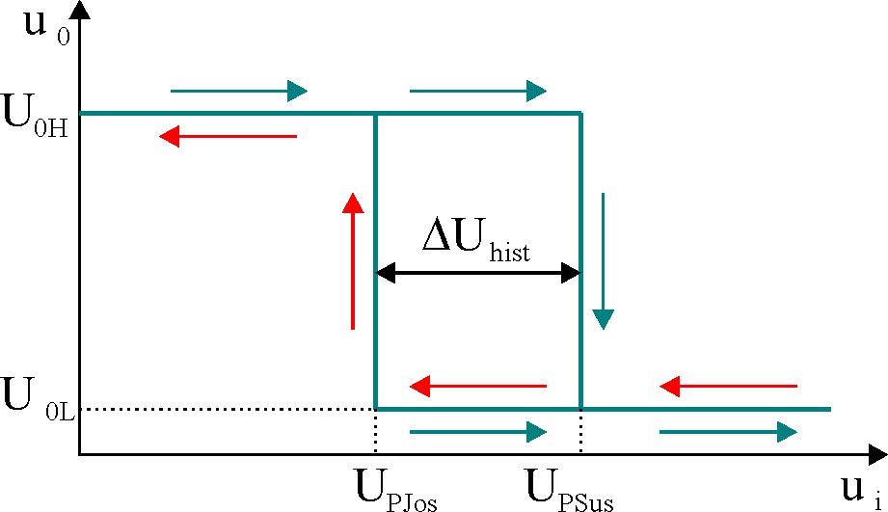
Transfer Characteristic
Why?

Slide 31
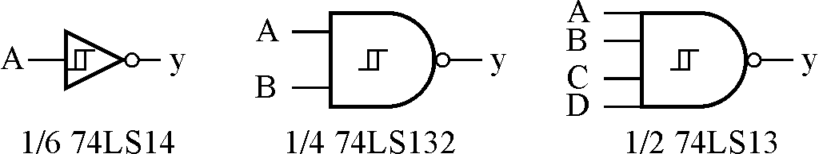
TTL Trigger Schmitt examples

Slide 32
Parameters
Threshold Voltages (7414, 7413, 74132): U_{PJos} = 1,1 V şi U_{PSus} = 1,9 V
Noise margin:
ΔU_{ZH} = U_{PJos} - U_{0Hmin} = 1,1 - 2,4 = - 1,3V
ΔU_{ZL} = U_{PSus} - U_{0LMax} = 1,9 - 0,4 = 1,5V
Better results

Slide 33
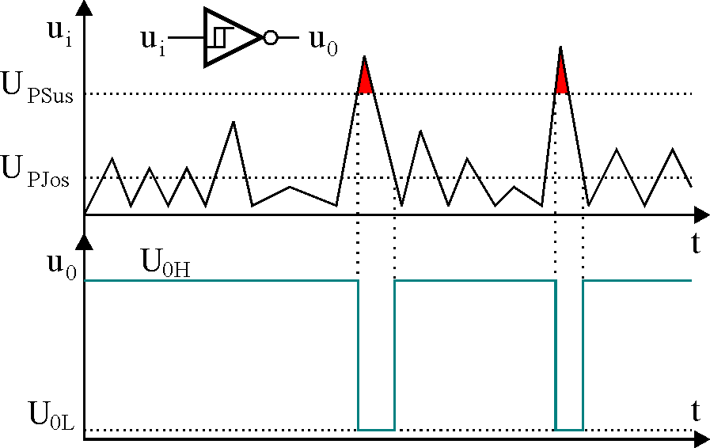
Trigger Schmitt - Applications
Input interface for noisy environments

Slide 34
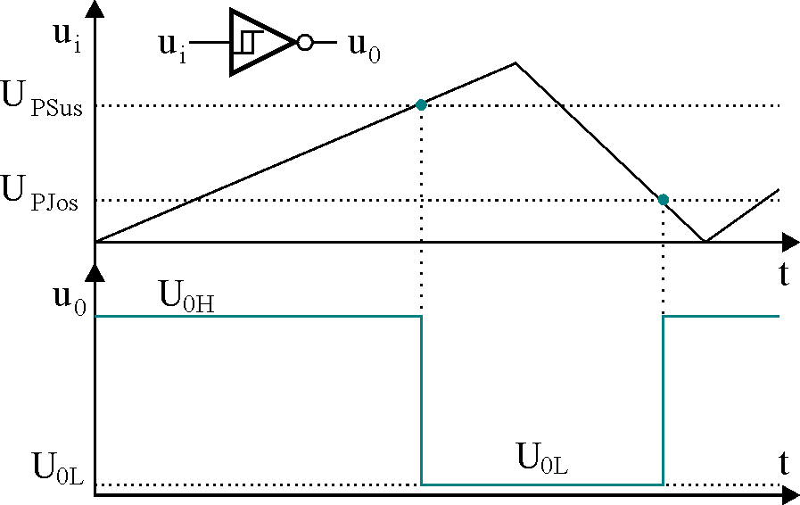
LF Signal Interface
Input interface for low frequency signals

Slide 35
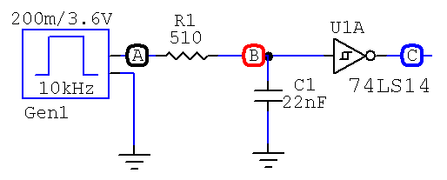
Delay Circuit
Simple delay circuits
Gen1 acts like a gate (V_{0L} = 200 mV, V_{0H} = 3,6 V)

Slide 36
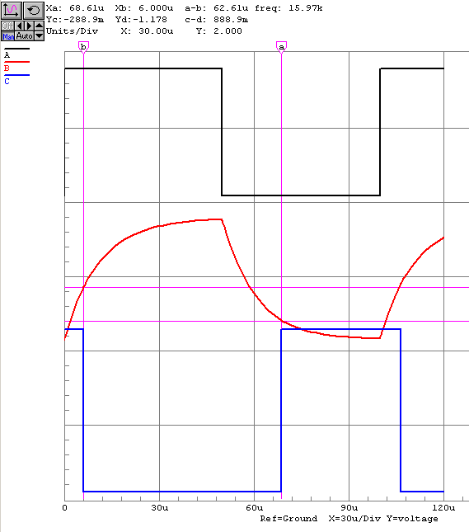
Delay circuit - timing

Slide 37
Delay Circuit
You know already:
For charging C:
;
so:
ie:

Slide 38
Delay Circuit
For discharging C,
;
so:
ie
Homework: Compare the simulation and analytical results

Slide 39
Trigger Schmitt - Applications
Edge detection
Signal generation
Homework: Find schematics for these applications

Slide 40
Other series

Slide 41
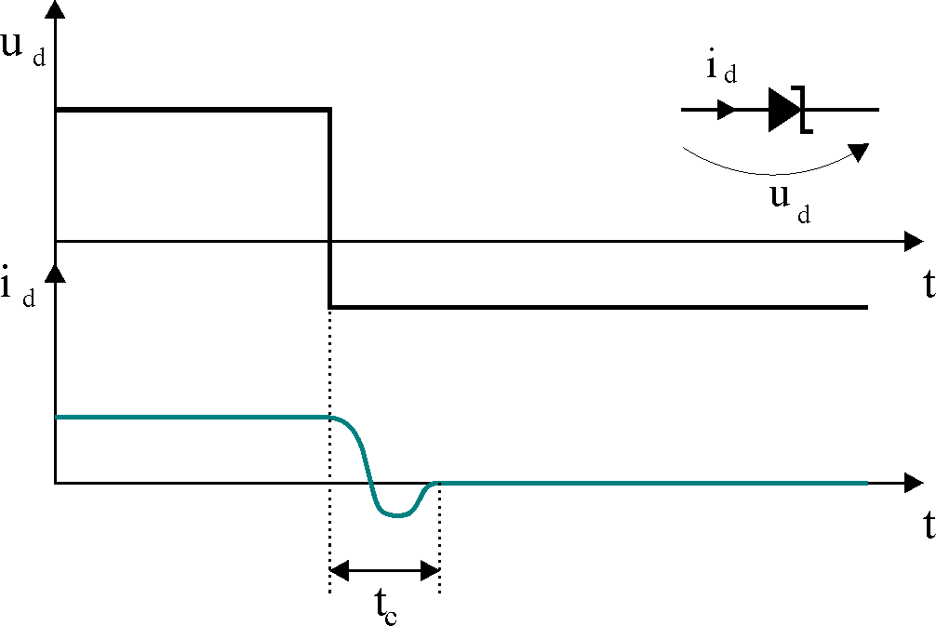
Schottky (S)
74Sxxx
Uses Schottky transistors
The Schottky diode
U_{d} = 0,3 ∼ 0,4V.
Fast switching time: t_{c} = 1 ns.

Slide 42
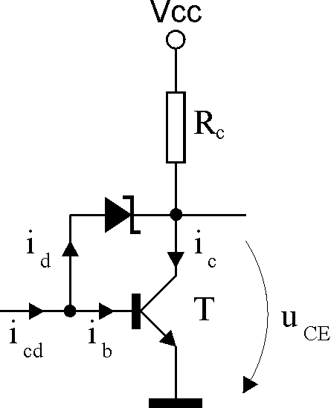
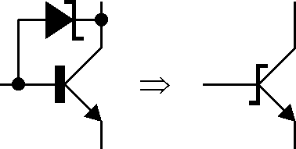
The Schottky Transistor
Cannot be saturated

Slide 43
TTL Schottky (S)
Good performance: t_{p}= 3 ns, P_{D} = 20mW
Higher U_{0L}: U_{0LMax} = 0,5V

Slide 44
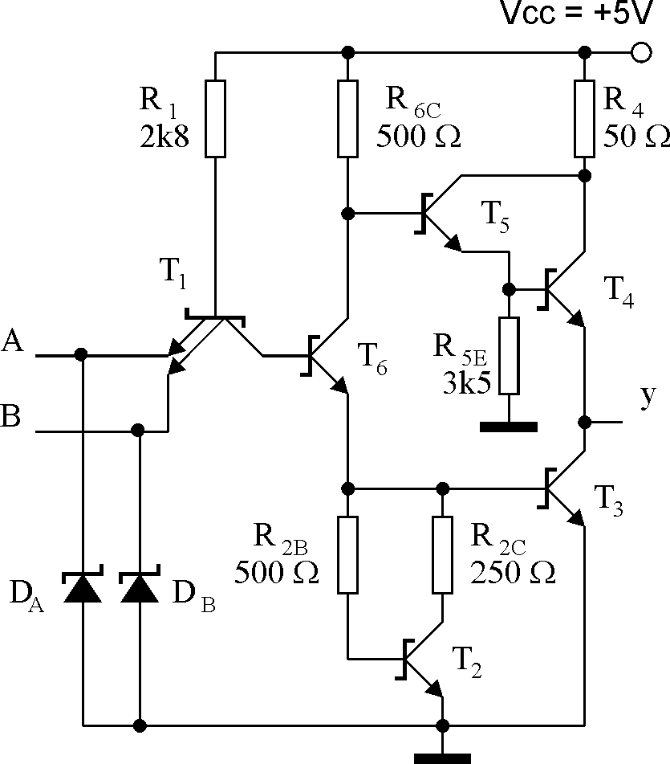
Schematic – 74S00

Slide 45
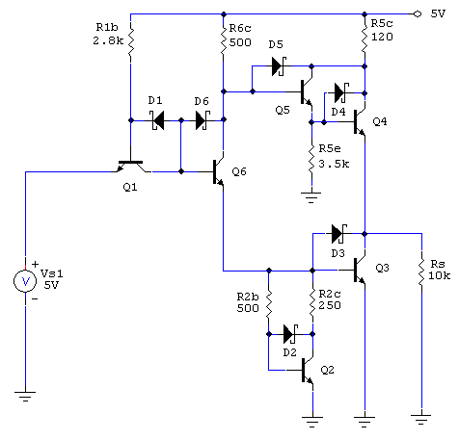
Simulation – 74S04

Slide 46
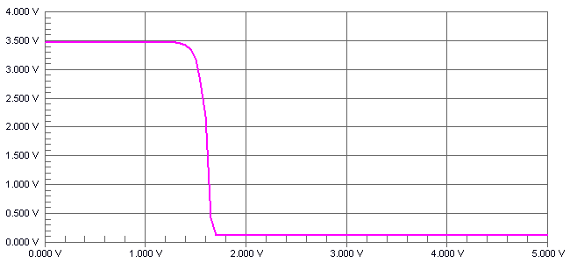
The Simulated Transfer Characteristic

Slide 47
Low Power Schottky (LS)
74LSxxx
Widely used
Low tp, low Pd
Schottky diodes on the input

Slide 48
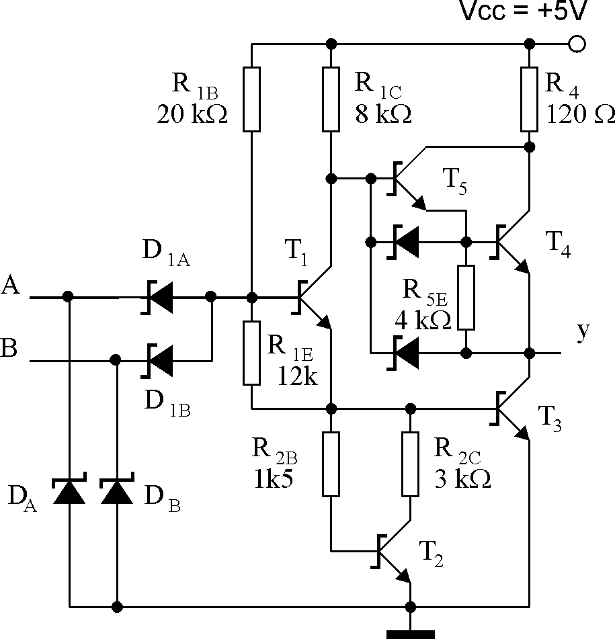
Schematic – 74LS00

Slide 49
Schematic – role of elements
R_{2E} – nonlinear
T₄ + T₅ = Darlington, (faster L-> H transition)
(Why)

Slide 50
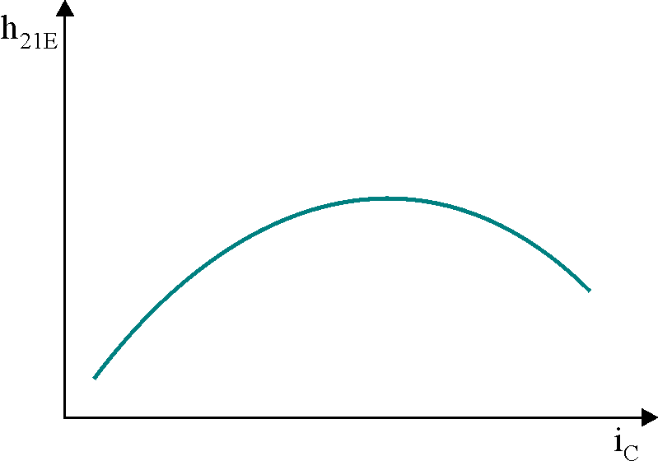
h_{21E}- i_{c} Plot

Slide 51
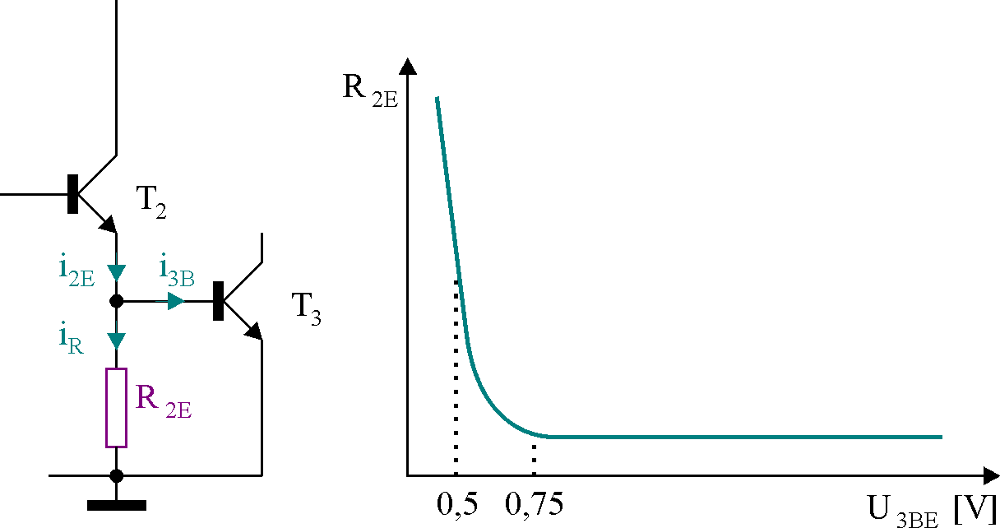
Non-linear resistorR_{2E}
Figura 3.48
Homework: simulate the above characteristicR_{2E} – U_{3BE}

Slide 52
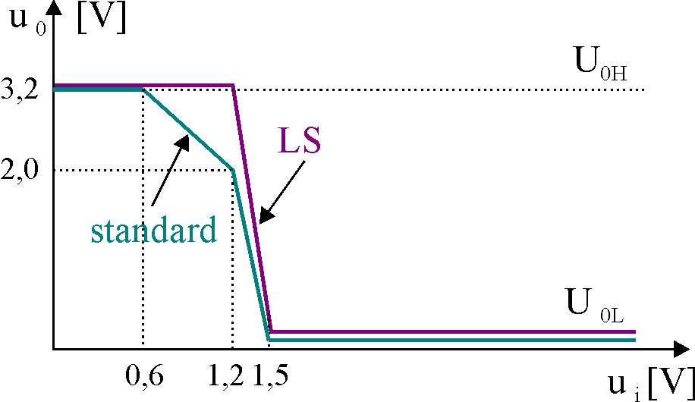
The transfer characteristic

Slide 53
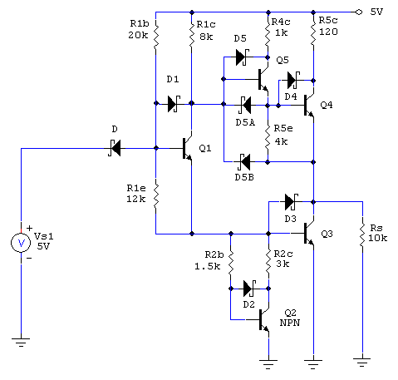
Schematic- CircuitMaker

Slide 54
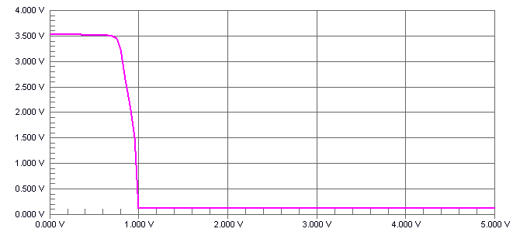
The simulated transfer characteristic

Slide 55
74ASxxx;74ALSxxx Series
Better technology, same schematic
Smaller components – faster chips
AS
t_{p} = 1,7; P_{D} = 8 mW, ceea ce
I_{iLMax} = 2mA şi I_{iHMax} = 0,2mA
U_{0LMax} = 0,5 V; U_{0Hmin} = 2,7 V
ALS
t_{p} = 4 ns, P_{D} = 1,2 mW,

Slide 56
Input and Output Currents
Family | Output |  | Input
 | I_{0HMax} | I_{0LMA}x | I_{iHMax} | I_{iLMax}
74 | - 0,8 mA | 16 mA | 40 μA | - 1,6 mA
74S | - 1 mA | 20 mA | 50 μA | - 2 mA
74AS | -2 mA | 20 mA | 20 μA | - 0,5 mA
74LS | - 0,4 mA | 8 mA | 20 μA | - 0,4 mA
74ALS | - 0,4 mA | 8 mA | 20 μA | - 0,1 mA
74F | - 1 mA | 20 mA | 20 μA | - 0,6 mA

Slide 57
Main parameters of the TTL family
Parameter Family | 74 | 74S | 74AS | 74LS | 74ALS | 74F
Dynamic parameter
Propagation delay[ns] | 9 | 3 | 1,7 | 9,5 | 4 | 3
Dissipated power [mW] | 10 | 20 | 8 | 2 | 1,2 | 6
…[pJ] | 90 | 60 | 13,6 | 19 | 4,8 | 18
Maximum frequency [MHz] | 35 | 125 | 200 | 45 | 70 | 100
Fan-Out (în cadrul aceleiaşi serii) | 10 | 20 | 40 | 20 | 20 | 33
Voltage levels
V_{0Hmin} | 2,4 | 2,7 | 2,5 | 2,7 | 2,5 | 2,5
V_{0LMax} | 0,4 | 0,5 | 0,5 | 0,5 | 0,5 | 0,5
V_{iHmin} | 2,0 | 2,0 | 2,0 | 2,0 | 2,0 | 2,0
V_{iLMax} | 0,8 | 0,8 | 0,8 | 0,8 | 0,8 | 0,8

Slide 58
9) Ten TTL loads per TTL driver is known as:
a) noise immunity b) fan-out c) power dissipation d) propagation delay
10) What is the standard TTL noise margin?
a) 5.0 V b) 0.0 V c) 0.8 V d) 0.4 V
11) The time needed for an output to change from the result of an input change is known as:
a) noise immunity b) fan-out c) propagation delay d) rise time
12) Totem-pole outputs _____ be connected _____ because _____.
a) can, in parallel, sometimes higher current is required
b) cannot, together, if the outputs are in opposite states excessively high currents can damage one or both devices
c) should, in series, certain applications may require higher output voltage
d) can, together, together they can handle larger load currents and higher output voltages
13) What should be done to unused inputs on TTL gates?
a) They should be left disconnected so as not to produce a load on any of the other circuits and to minimize power loading on the voltage source.
b) All unused gates should be connected together and tied to V through a 1 komega.gif resistor.
c) All unused inputs should be connected to an unused output; this will ensure compatible loading on both the unused inputs and unused outputs.
d) Unused AND and NAND inputs should be tied to VCC through a 1 komega.gif resistor; unused OR and NOR inputs should be grounded.

